Slide 1
AnchorPro
Prepared by Dan Miller

Slide 2




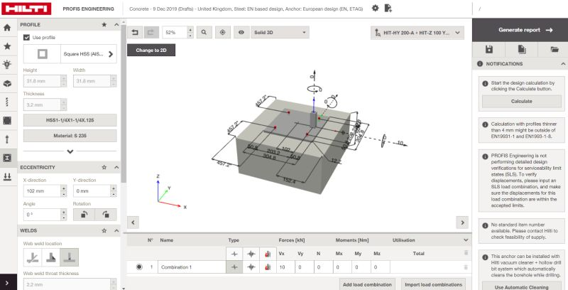
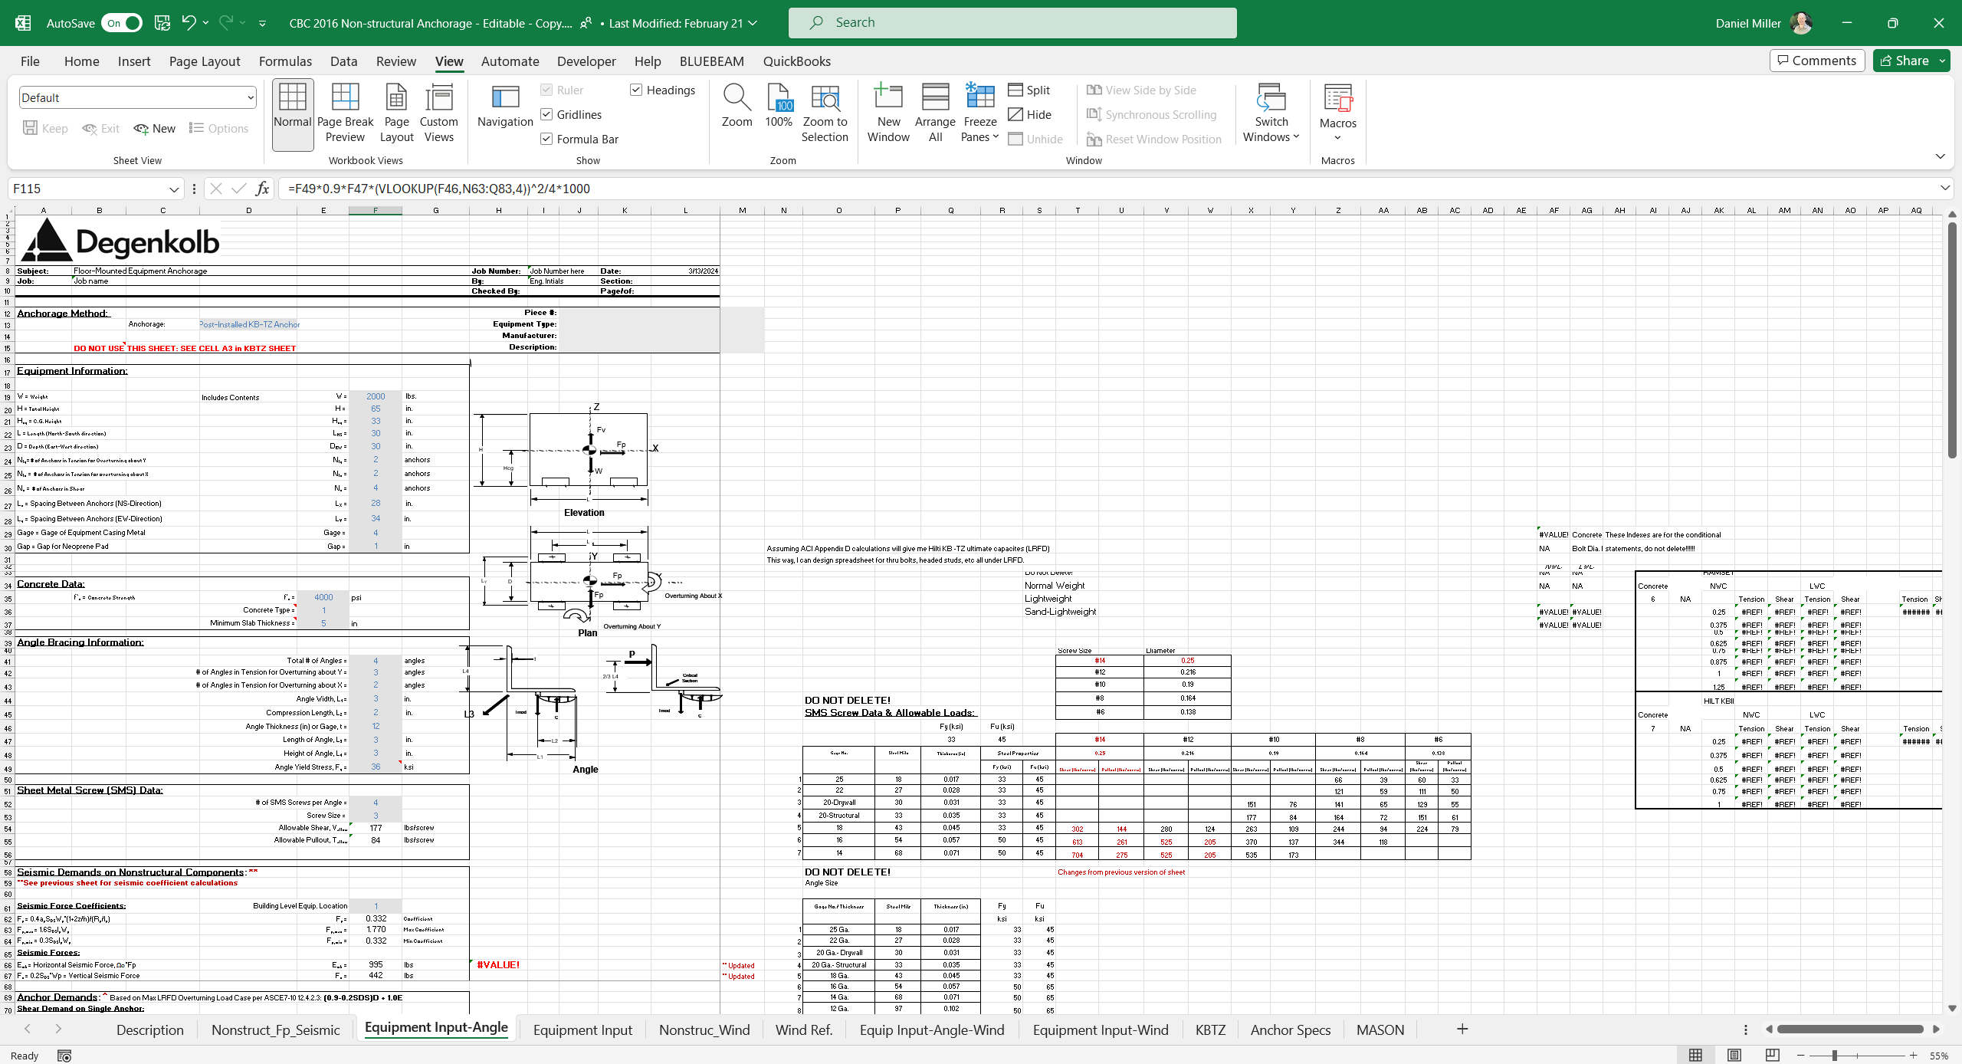
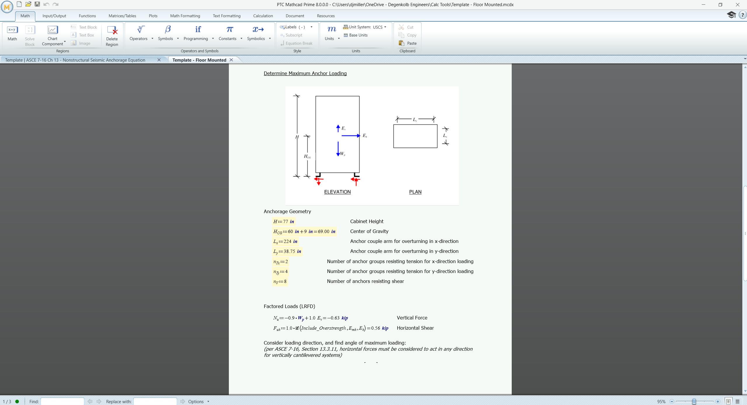

Current Packaging workflow
Populate Equipment Schedule
Calculate Equipment Forces and Anchor Demands
Calculate Anchor Capacity using third-party software
Assemble Calculation Package
Develop Drawing Details
Hand Calcs and Ad-Hoc Worksheets

Slide 3
Current Packaging workflow
Limitations
Ad-hoc analysis methodology
Inconsistent (often overly-conservative) calculation assumptions
Inefficient for evaluation of multiple units or anchorage products
Calculation package must be compiled from multiple sources

Slide 4
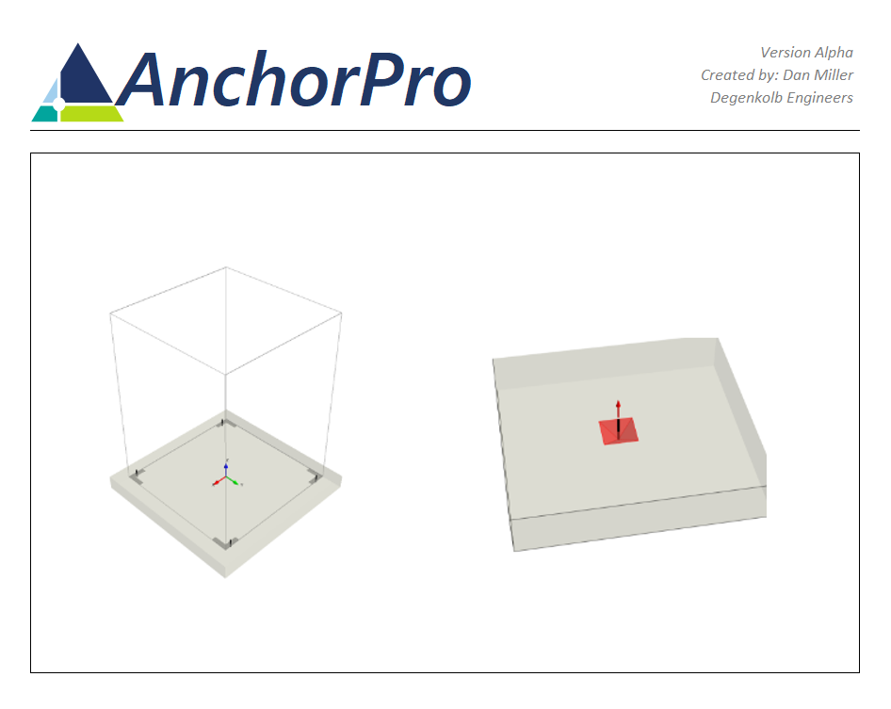
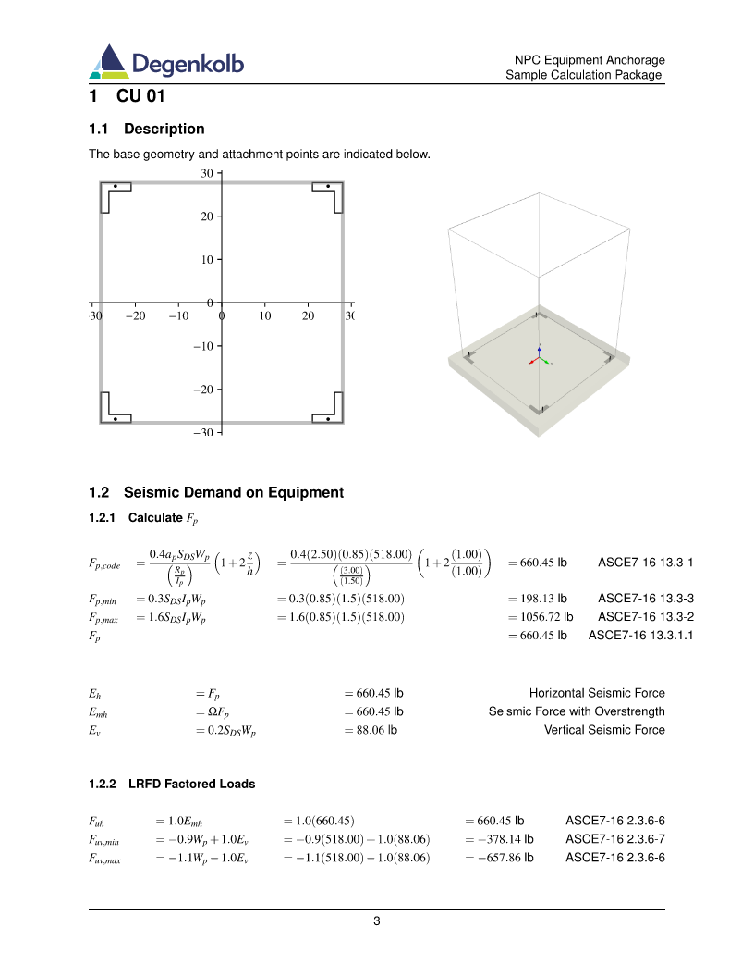
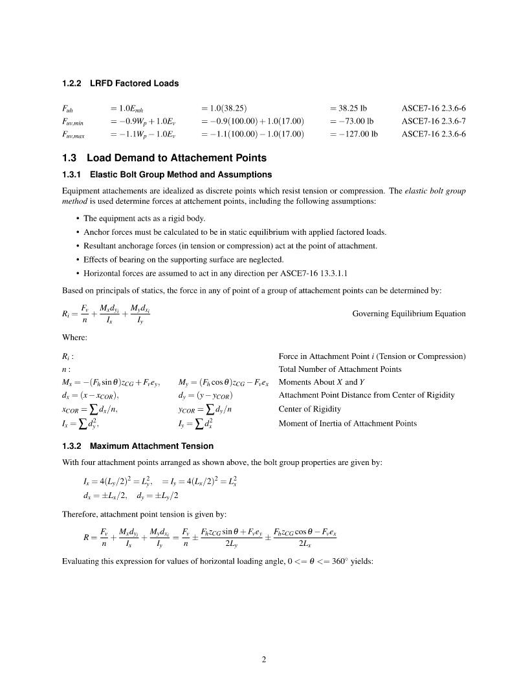
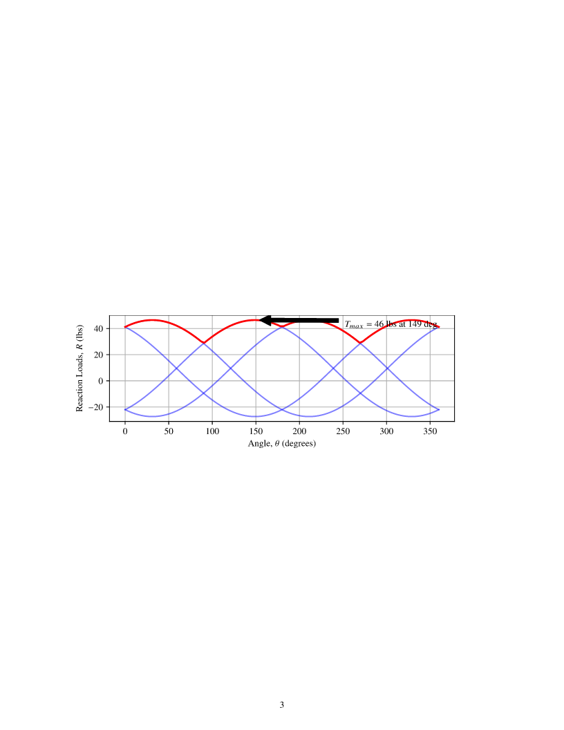
equipment anchorage using AnchorPro
Populate Equipment Schedule
Calculate deign loads (ASCE 7, CBC, etc.)
Compute anchor demands by structural analysis
Compute anchor capacity and breakout
Complete and clear calculation report

Slide 5
Automated Equipment Anchorage
Advantages
General: any geometry, any attachment configuration
Robust analysis methodology
One-stop-shop
  Vertically integrated calculations
  Anchorage products from multiple manufacturers
Automated: analyze multiple units and multiple anchor products with one click.
Professional

Slide 6
Automated Equipment Anchorage
Applications
General project work
Integration with NPC drawing automation
Online anchorage service (Ongoing HUB proposal)
Direct commercialization

